Slide 1













road
revolutioners
By:
sneha soniwal
dhairyajeet singh
ishika ahuja
niyati

Slide 2
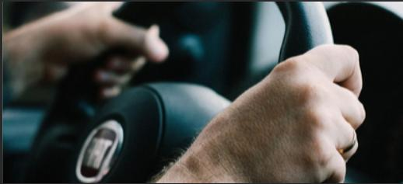
Problem Statement
“The challenge empowers participants to reimagine the possibilities in vehicle safety and communication. We seek innovative solutions that harness cutting-edge technology to redefine our experience and interaction with vehicles.”

Slide 3


Causes of road accidents
others
10.1%
driving on wrong side
4.8%
drink and drive
2.6%
Over-Speeding
Drunk driving
Distracted driving
Reckless driving
overspeeding
82.6%

Slide 4
Solutions
01
03
In case of Vehicle breakdown, we provide the location and phone number of garages and mechanics closest to the user’s location
Additionaly provide a timely reminder for maintenance of vehicles.
Provides speed limits, gives alerts and informs authorities in the case of user not adhering to the speed limit for a certain duration
02
04
During a case of some accident notifications/alerts will be passed out to the closest authorities. This quick response might help in saving some precious lives.
AI chat bot provides the safest and most efficient route to travel from one place to another

Slide 5

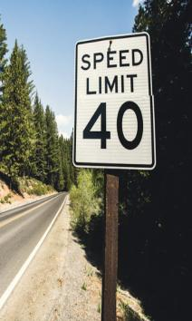
Speed limit
1. Notification of Speed Limit Violation
- When the user exceeds the speed limit, immediately notify them.
- Clearly state the current speed limit in the notification.
- Politely ask the user to adhere to the posted speed limit
2. Monitoring User Compliance:
- Continuously monitor the user's speed.
- If the user continues to exceed the speed limit after the initial notification, record the duration of non-compliance.
3. Final Warning:
- If the user exceeds the speed limit for a specified duration (e.g., 5 minutes),
issue a final warning
- Emphasize the importance of adhering to speed limits for safety.
4. Notifying Authorities:
- If the user does not comply with the final warning, promptly inform the relevant authorities.
- Provide them with all necessary details, including the user's location and vehicle information.

Slide 6

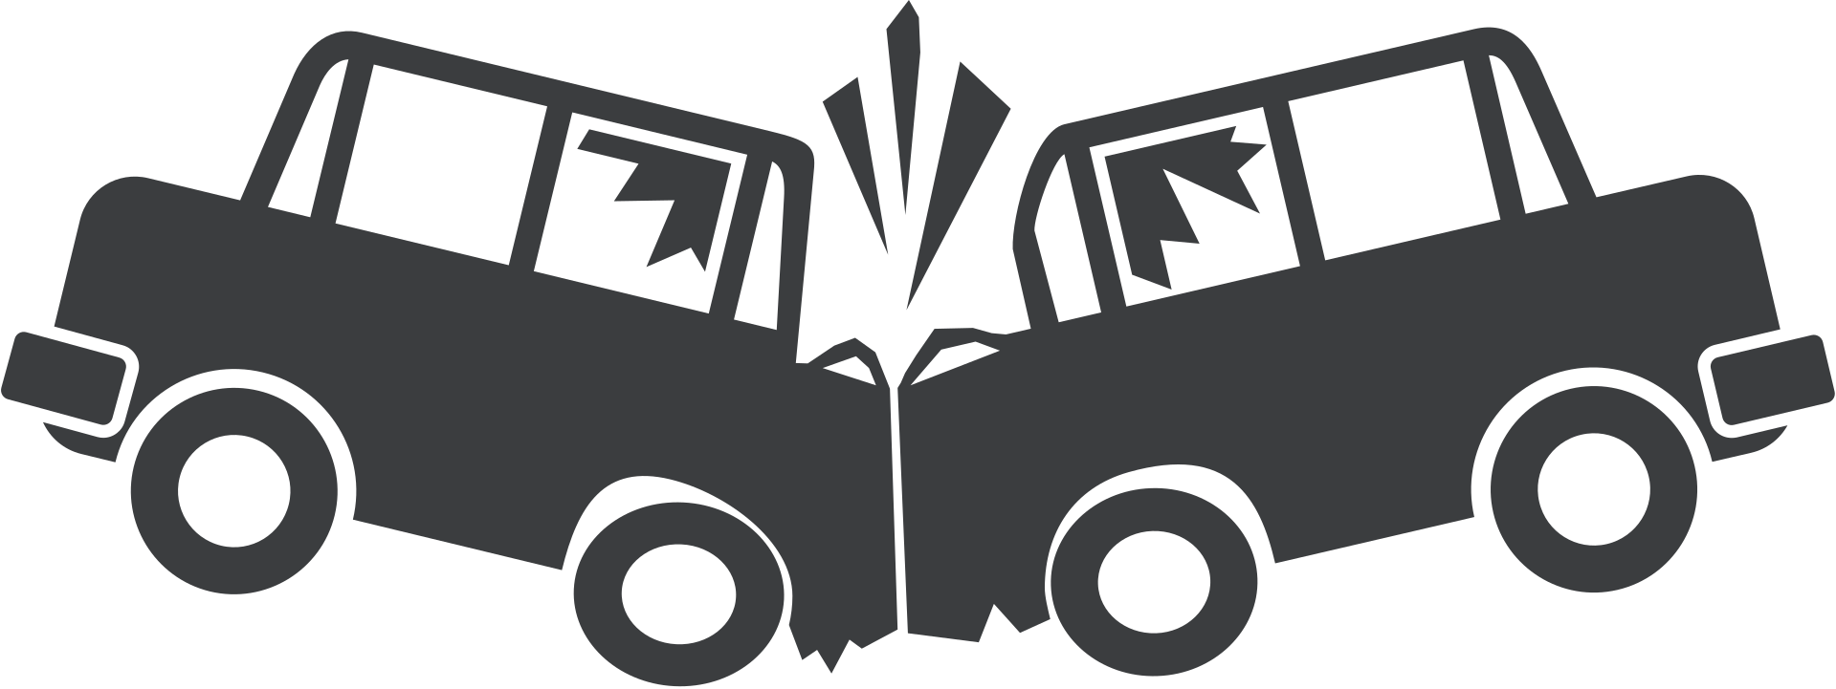


In case of accident
Immediate health assistance:
immediately an alert will be sent to the nearest Hospitals,
Fire stations and users family.
Vehicle breakdown:
information related to nearest:
garages/mechanics
fuel/C.N.G stations
EVSE (Electric Vehicle Supply Equipment)

Slide 7
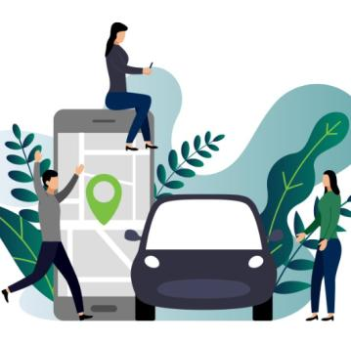
Future Prospective
01
Introduction of E-Chalaan on speeding and drunk driving.We aim to do this via tie-up with government
02
Creating a ML model integration with Government data base which handles your insurance and other vehicle safety policies

Slide 8


Tech Stack
Frontend:
HTML 5, CSS, JavaScript, React JS
Backend:
Google Map API’s, AI integration.
Unique factors:
Alerts pop up through AI chat Bot
Model utilization:
Website and Mobile App
Stack for future Goals:
AI/ML model

Slide 9


Data collection
We will collect data by utilizing cameras placed on roads. This will involve collaborating with various entities, including shop owners, homeowners, traffic signals, toll booths, police checkpoints, highways, major roads, metro stations, and public places.
Additionally, we will seek volunteers to provide data from these cameras, which will aid in verification and record-keeping. In special cases, such as crimes, footage from these cameras will be used as evidence.
Data security
User consent: A very important aspect of the success of our project is user consent, we would take well-informed consent from the user before using their location.
Minimized data collection: only necessary data will be collected
Encrypted data: collected data will be stored securely using encryption
User’s strength: User has a complete choice to remove or edit their data whenever they want to.
Ethical data usage: data provided by the user will be used ethically and any harmful actions will be avoided.
Data usage: No usage of critical and personal data.

Slide 10
Thank you!
By Team Road Revolutioners

